Slide 1
by
PowerPoint Slide Specifications

Slide 2
Security Printers
All screens in The Convention Centre Dublin (CCD) are in widescreen (16:9) format.
Please follow the instructions in this presentation to ensure that your slides fill the screen.
PowerPoint 2007 default is 4:3 and you have to reset it
PowerPoint 2010 default is also 4:3
PowerPoint 2013 default screen size is 16:9
Before you start generating your presentation, change your PowerPoint’s slide size to widescreen 16:9. Your presentation will then display as you have built it, on any screen. If you do not do this, there will be black bars at the top and bottom, or left and right, or both, and your photos and other graphics will be distorted !

Slide 3
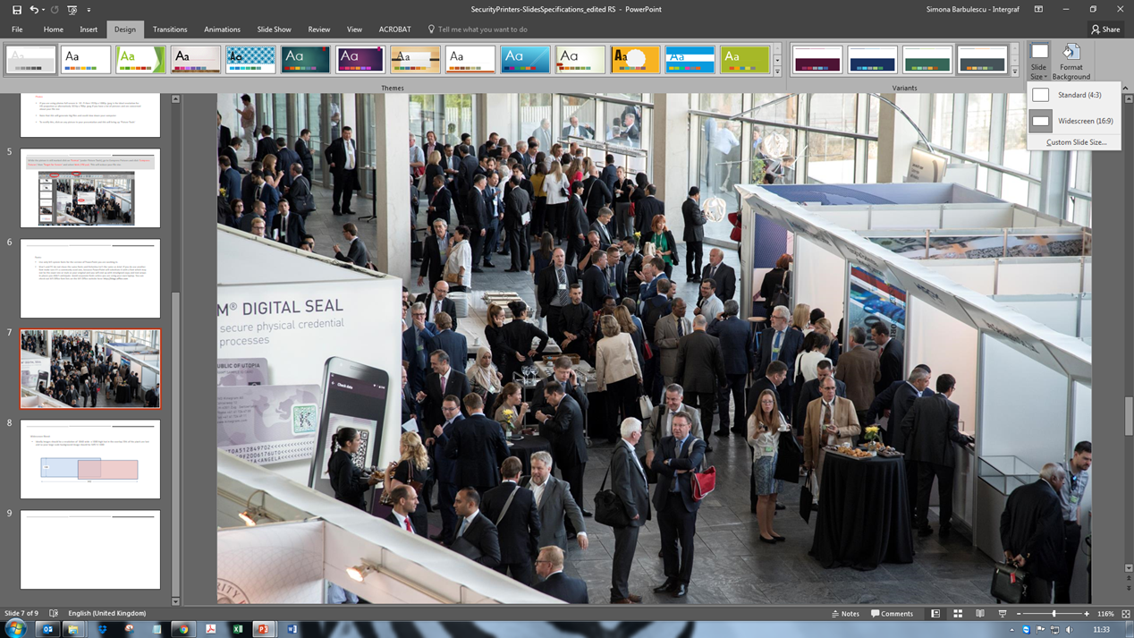
Security Printers
First go to the Design tab at the top of the page, then select Slide Size, Widescreen (16:9)

Slide 4
Security Printers
Logos
Your logo(s) should be in .png format, generated from high-resolution vector images, ideally saved from an Illustrator document.
This will give you an image that can be scaled to any size and remain sharp on projection.
Photos
If you are using photos full screen, i.e. 16:9, the ideal resolution of your .jpg or .jpeg for HD projection is 1920 x 1080 px, or alternatively, 1024 x 768 px if you have a lot of pictures and are concerned about the size of your PowerPoint file.
Please be aware that using a large number of photos will generate big files and could slow down your computer.
To avoid this, click on any picture in your presentation and go to Picture Tools.

Slide 5
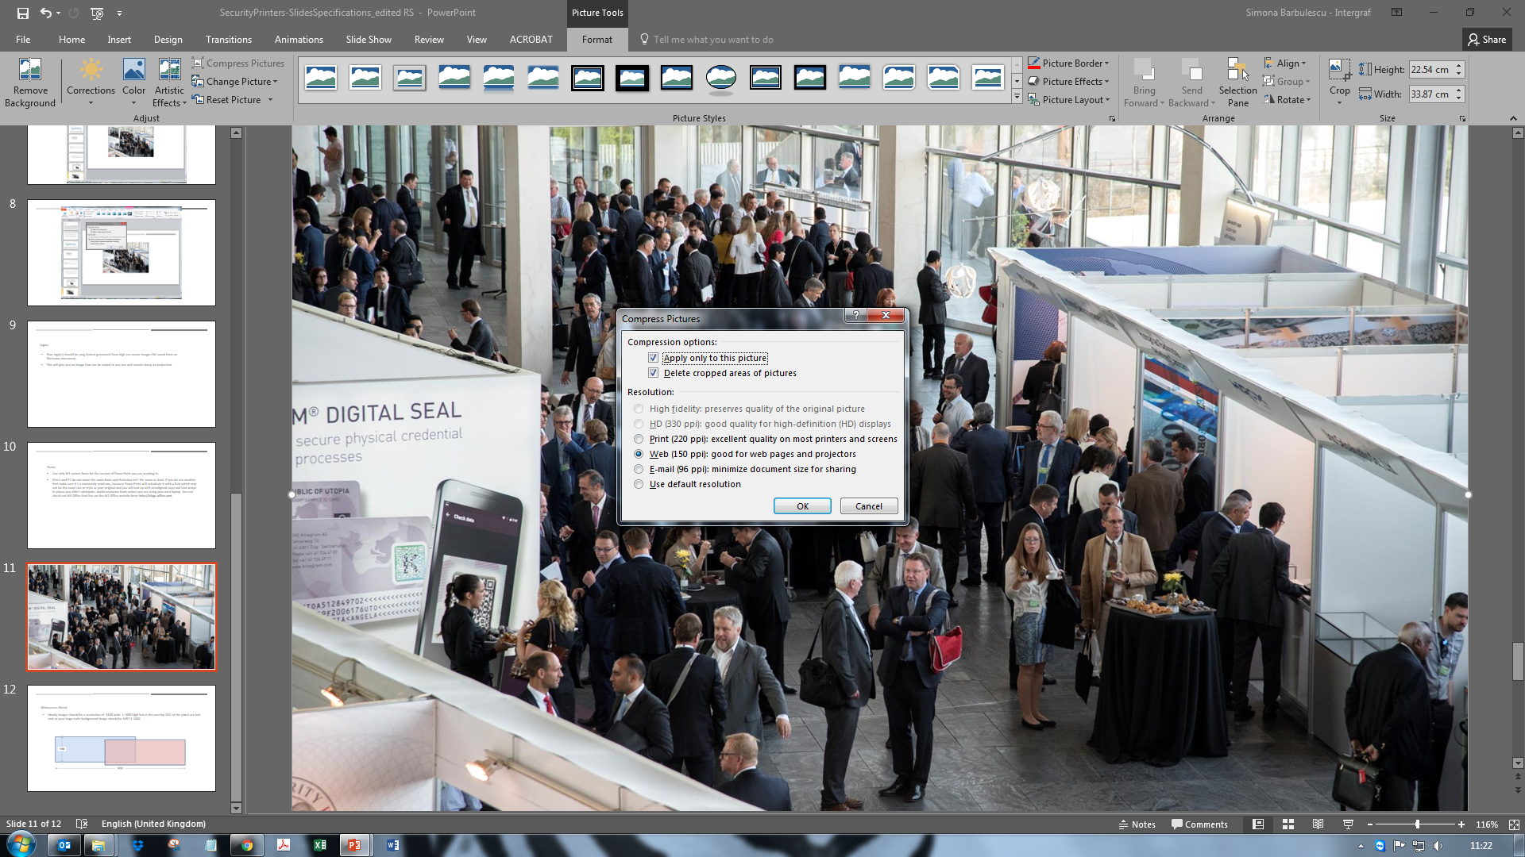
While the picture is selected, click on Format (under Picture Tools). Go to Compress Pictures and click on Compress Pictures, then Target for Screen, and select Web (150 ppi). This will reduce the size of your file.

Slide 6
Fonts
Use only fonts supplied with Microsoft Office for the version of PowerPoint you are working in.
Macs and PCs do not share the same fonts. Helvetica (Mac) is not the same as Arial (Microsoft). If you do use another font, make sure you pick one that is commonly used. Otherwise PowerPoint will substitute it with another font that may not be the exact size or style as the one you originally used. You will then end up with misaligned copy and text-wraps in places you did not anticipate. Avoid corporate fonts, unless you are using your own laptop. You can check out the list of Microsoft Office fonts on the Microsoft website.

Slide 7
Widescreen blend
Ideally, images should be 3840 wide x 1080 high, but 20% of the pixels are lost in the overlap. So your large scale background image should rather be 3452 wide x 1080 high.
1080
3452

